Slide 1
Planing

Slide 2
Planning
✓ Planning refers to the process of choosing/computing the correct sequence of steps to solve a given problem.
✓ To do this we need some convenient representation of the problem domain. We can define states in some formal language, such as a subset of predicate logic, or a series of rules.
✓ A plan can then be seen as a sequence of operations that transform the initial state into the goal state, i.e. the problem solution. Typically we will use some kind of search algorithm to find a good plan.

Slide 3
Planing
The task of coming up with a sequence of actions that will achieve a goal is called planning.
We have seen two examples of planning agents so far: the search-based probleim-solving agent
We also saw that a knowledge-based agents can select actions based on explicit, logical representations of the current state and the effects of actions. This allows the agent to succeed in complex, inaccessible environments that are too difficult for a problem-solving agent ent and the logical planning agent.
Problem Solving Agents + Knowledge-based Agents = Planning Agents

Slide 4
The Planning Problem
Formally a planning algorithm has three inputs:
A description of the world in some formal language,
A description of the agent’s goal in some formal language, and
A description of the possible actions that can be performed.
The planner’s o/p is a sequence of actions which when executed in any world satisfying the initial state description will achieve the goal.

Slide 5
Representation for states and goals
In the STRIPS language, states are represented by conjunctions of function-free ground literals, that is, predicates applied to constant symbols, possibly negated. For example,
At(Home)^ ¬ Have(Milk)^ ¬ Have(Bananas)^ ¬ Have(Drill)^….
Goals are also described by conjunctions of literals. For example,
At(Home)^Have(Milk)^ Have(Bananas)^ Have(Drill)
Goals can also contain variables. For example, the goal of being at a store that sells milk would be represented as

Slide 6
Representations for actions
Our STRIPS operators consist of three components:
The action description is what an agent actually returns to the environment in order to do something.
The precondition is a conjunction of atoms (positive literals) that says what must be true before the operator can be applied.
The effect of an operator is a conjunction of literals (positive or negative) that describes how the situation changes when the operator is applied.
Here’s an example for the operator for going from one place to another:
Op(Action:Go(there), Precond:At(here)^Path(here, there), Effect:At(there)^ ¬At(here))

Slide 7
Search through World Space
The simplest way to build a planner is to cast the planning problem as search through the space of world states. Each node in the graph denotes a state of the world, and arcs connect worlds that can be reached by executing a single action. We would call it a situation space planner because it searches through the space of possible situations.
There are two types of planners:
Progression Planner: it searches forward from the initial situation to the goal situation.
Regression Planner: it searches backward from the goal situation to the initial situation.

Slide 8
Search through the Space of Plans
An alternative is to search through space of plans rather than space of situations i.e plan-space node denote plans
Start with a simple partial plan
Expand the plan until the complete plan is developed
Operators in this step:
  Adding a step
  Imposing an ordering that puts one step after another
  Instantiating a previously unbound variable
The solution → final plan Path → irrelevant

Slide 9
Representation of Plans
Consider a simple problem:
  Putting on a pair of shoes
Goal →RightShoeOn ^ LeftShoeOn
Four operators:
  Op(Action:RightShoe,PreCond:RightSockOn,Effect:RightShoeON)
  Op(Action:RightSock , Effect: RightSockOn)
  Op(Action:LeftShoe, Precond:LeftSockOn, Effect:LeftShoeOn)
  Op(Action:LeftSock,Effect:LeftSockOn)

Slide 10
Least Commitment –
One should make choices only about things that you currently care about ,leaving the others to be worked out later.
Partial Order Planner –
A planner that can represent plans in which some steps are ordered (before or after) w.r.t each other and other steps are unordered.
Total Order Planner—
Planner in which plans consist of a simple lists of steps
Linearization of P—
A totally ordered plan that is derived from a plan P by adding constraints

Slide 11
Partial Order Plans:
Total Order Plans:
Start
Start
Start
Start
Start
Start
Start
Right
Sock
Right
Sock
Left
Sock
Left
Sock
Right
Sock
Left
Sock
Left
Sock
Right
Sock
Left
Sock
Left
Sock
Right
Sock
Right
Sock
Right
Shoe
Left
Shoe
Left Sock on
Right Sock on
Left
Shoe
Right
Shoe
Right
Shoe
Left
Sock
Right
Shoe
Left
Shoe
Left
Sock
Right
Sock
Left Shoe on
Right Shoe on
Left
Shoe
Right
Shoe
Left
Shoe
Right
Shoe
Left
Shoe
Right
Shoe
Finish
Finish
Finish
Finish
Finish
Finish
Finish

Slide 12
Plans,Causal Links and Threats
Representing a Plan as a three tuple :-- <A,O,L>
  A → Set of Actions
  L → Set of Causal Links
  O → Set of Ordering constraints over A
If A ={A1,A2,A3} then O might be set{A1<A3,A2<A3}
These constraints specify a plan in which A3 is necessarily the last action but does not commit to a choice of which of the three actions comes first .
As least commitment planners refine their plans, they must do constraint satisfaction to ensure consistency of O

Slide 13
Start
At(s),Sells(s,Drill)
At(s),Sells(s,Milk)
At(s),Sells(s,Bananas)
Buy(Drill)
Buy(Milk)
Buy(bananas)
Have(Drill),Have(Milk),Have(Bananas),At(Home)
Finish
Start
At(HWS),Sells(HWS,Drill)
At(SM),Sells(SM,Milk)
At(SM),Sells(SM,Bananas)
Buy(Drill)
Buy(Milk)
Buy(bananas)
Have(Drill),Have(Milk),Have(Bananas),At(Home)
Finish

Slide 14
Start
At(Home)
At(Home)
Go(HWS)
Go(SM)
At(HWS),Sells(HWS,Drill)
At(SM),Sells(SM,Milk)
At(SM),Sells(SM,Bananas)
Buy(Drill)
Buy(Milk)
Buy(bananas)
Have(Drill),Have(Milk),Have(Bananas),At(Home)
Finish

Slide 15
Start
At(x)
At(x)
Go(HWS)
Go(SM)
At(HWS),Sells(HWS,Drill)
At(SM),Sells(SM,Milk)
At(SM),Sells(SM,Bananas)
Buy(Drill)
Buy(Milk)
Buy(bananas)
Have(Drill),Have(Milk),Have(Bananas),At(Home)
Finish

Slide 16
Causal Links—
A Causal Links is written as S_{i} ^{c}→ S_{j} and read as “ S_{i} achieves c for S_{j} “.Causal Links serve to record the purpose of steps in the plan:here a purpose of S_{i} is to achieve the precondition c of S_{j}
Threat –
Causal Links are used to detect when a newly introduced action interferes with past decision. Such an action is called a Threat.
Let At be a different action in A : we sat that A t threatens A_{p} ^{Q}→ A_{c} when the two criteria are met:
  O U{A_{p}<A_{t}<A_{c}} is consistent
  A_{t} has ¬Q as an effect.

Slide 17
Resolving Threats
When a plan contains a threat , then there is a danger that the plan won’t work as anticipated i.e. We have reached a dead-end in the search.
The causal link S1 ^{c}→ S2 is threatened by a new step S3 because one effect of S3 is to delete c.
The way to resolve the Threat is to add ordering constraints to make sure that S3 does not intervene between S1 and S2
Demotion -- S3 is placed before S1 .
Promotion – S3 is placed after S2.

Slide 18
S3
S1
S1
¬C
S1
C
S3
C
¬C
C
S2
S2
S2
S3
¬C

Slide 19
Start
At(Home)
At(Home)
Go(HWS)
Go(SM)
At(HWS),Sells(HWS,Drill)
At(SM),Sells(SM,Milk)
At(SM),Sells(SM,Bananas)
Buy(Drill)
Buy(Milk)
Buy(bananas)
Go(Home)
Have(Drill),Have(Milk),Have(Bananas),At(Home)
Finish

Slide 20
Start
At(Home)
Go(HWS)
At(HWS),Sells(HWS,Drill)
Buy(Drill)
At(HWS)
Go(SM)
At(SM),Sells(SM,Milk)
At(SM),Sells(SM,Bananas)
Buy(Milk)
Buy(bananas)
At(SM)
GO(Home)
Have(Drill),Have(Milk),Have(Bananas),At(Home)
Finish

Slide 21
Algorithm of a simple planning agent:
1. Generate a goal to achieve
2. Construct a plan to achieve goal from current state
3. Execute plan until finished
4. Begin again with new goal
The agent first generates a goal to achieve, and then constructs a plan to achieve it from the current state. Once it has a plan, it keeps executing it until the plan is finished, then begins again with a new goal.
This is illustrated in the following pseudocode:
function SIMPLE-PLANNING-AGENT (percept) returns an action static: KB, a knowledge base(includes action descriptions) p , a plan, initially NoPlan t, a counter, initially 0, indicating time local variables: G, a goal current, a current state description

Slide 22
Assumptions
A simple planning agent create and use plans based on the following assumptions:
• Atomic time: each action is indivisible
• No concurrent actions allowed
• Deterministic actions: result of each actions is completely determined by the definition of the action, and there is no uncertainty in performing it in the world.
• Agent is the sole cause of change in the world.
• Agent is omniscient: has complete knowledge of the state of the world
Closed world assumption: everything known to be true in the world is included in a state description. Anything not listed is false

Slide 23
Problem Solving vs. Planning
A simple planning agent is very similar to problem-solving agents in that it constructs plans that achieve its goals, and then executes them. The limitations of the problem-solving approach motivates the design of planning systems.
To solve a planning problem using a state-space search approach we would let the:
initial state = initial situation
• goal-test predicate = goal state description
• successor function computed from the set of operators
• once a goal is found, solution plan is the sequence of operators in the path from the start node to the goal node

Slide 24
Remember the search-based problem solver had four basic elements:
Representations of actions: programs that develop successor state descriptions which represent actions.
Representation of state: every state description is complete. This is because a complete description of the initial state is given, and actions are represented by a program that creates complete state descriptions.
Representation of goals: a problem solving agent has only information about it's goal, which is in terms of a goal test and the heuristic function.
Representation of plans: in problem solving, the solution is a sequence of actions.

Slide 25
In a simple problem: "Get a quart of milk and a bunch of bananas and a variable speed cordless drill" for a problem solving exercise we need to specify:
Initial State: the agent is at home without any objects that he is wanting.
Operator Set: everything the agent can do.
Heuristic function: the # of things that have not yet been acquired.
Problems with

Slide 26
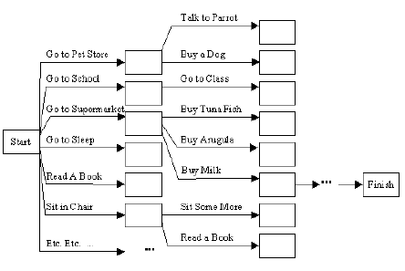
In a simple problem: "Get a quart of milk and a bunch of bananas and a variable speed cordless drill" for a problem solving exercise we need to specify:
Problems with Problem solving agent:
The previous figure illustrates the actual branching factor would be in the thousands or millions. The heuristic evaluation function can only choose states to determine which one is closer to the goal. It cannot eliminate actions from consideration. The agent makes guesses by considering actions and the evaluation function ranks those guesses. The agent picks the best guess, but then has no idea what to try next and therefore starts guessing again.
It considers sequences of actions beginning from the initial state. The agent is forced to decide what to do in the initial state first, where possible choices are to go to any of the next places. Until the agent decides how to acquire the objects, it can't decide where to go.

Slide 27
Total v. Partial Order plans
Total-order planner
  maintains a partial solution as a totally ordered list of steps found so far
  STRIPS
Partial-order planner
  only maintains partial order constraints on operators in the plan
    e.g., temporal constraints: S1 < S2 [S1 must come before S2, but not necessarily immediately before it]

Slide 28
Principle of least commitment
Don’t make an ordering choice, unless required to do so
Keep the ordering choice as general as possible
  S1 < S2 v. S1 → S2
Reduces the amount of backtracking needed
  don’t waste time undoing steps
Partial-order planners have this property of least commitment
  situational planners don’t

Slide 29
Types of “links”
Temporal: ordering constraint
  G1 < G2: G1 must occur before G2
  graph
Causal
  S_{i} →_{c} S_{j}
  S_{i} achieves c for S_{j}
  in the effects list of S_{i} is a literal c that is needed to satisfy part of the precondition for the operator S_{j}
  records the purpose of a step in the plan

Slide 30
Creating partial order plans
Search through a space of (partial-order) plans
Each node is a partial-order plan
Each arc from a state (operator) consists in either
  adding a new step to the plan
  adding a temporal & causal constraint between existing steps
Situation-space planners, conversely, commit to an ordering when an operator is applied

Slide 31
Initializing the algorithm
Start node
  preconditions: none
  effects: positive literals defining the start state
Finish node
  preconditions: goal
  effects: none
Initial plan
  Start ---------------> Finish

Slide 32
Finishing the algorithm
A solution is a complete and consistent plan
(see page 349, for the definitions of complete and consistent plan)

Slide 33
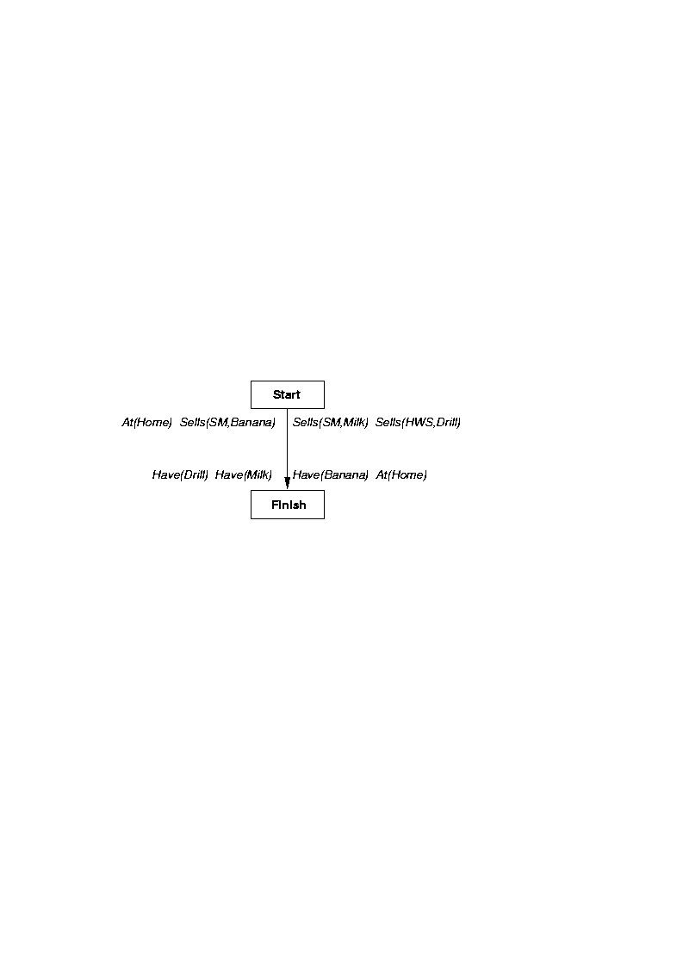
Example Problem

Slide 34
Interleaving v. non-interleaving planner
Non-interleaving planner
  all of the steps for a sub-goal occur “atomically”
  G1 ^ G2: either all of the steps for achieving G1 occur before G2, or all of the steps for achieving G1 occur after G2
  STRIPS is non-interleaving because it uses a stack mechanism
  cannot solve the Sussman anomaly

Slide 35
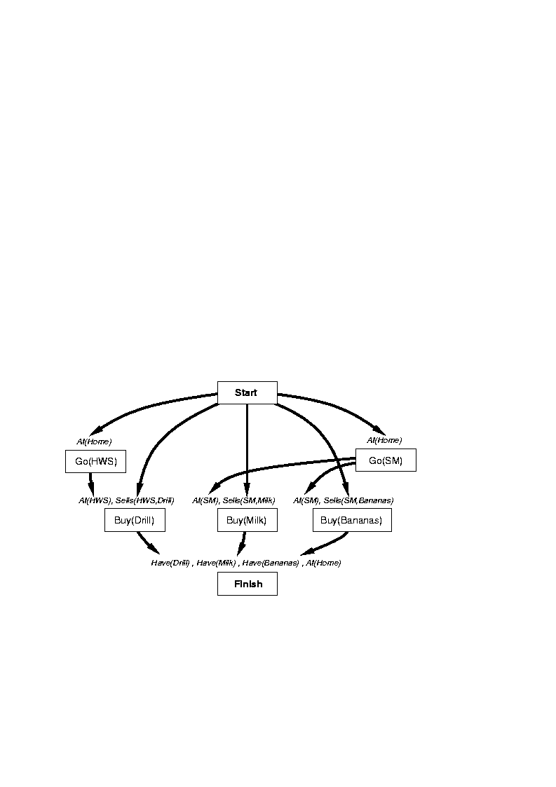
Flawed Plan

Slide 36
Establishment
Solve an open/unsatisfied precondition p
  a precondition is not satisfied if it does not have a causal link to it
Simple establishment
  Find an existing step T prior to S in which p is true (it’s in the Effects list of T)
Step addition
  Add a new plan step T that contains in its Effects list p
Add both a causal & temporal link from T to S

Slide 37
Declobbering = threat removal
Threat
  G2 requires an effect of G1 (there is a causal link between G1 & G2), but the effect of G3 is to undo the needed effect
  picture
Thus, G3 can’t occur between G2 & G3
  it must occur either before G1 (promotion)
    add temporal link G3 < G1
  or after G2 (demotion)
    add temporal link G2 < G3

Slide 38
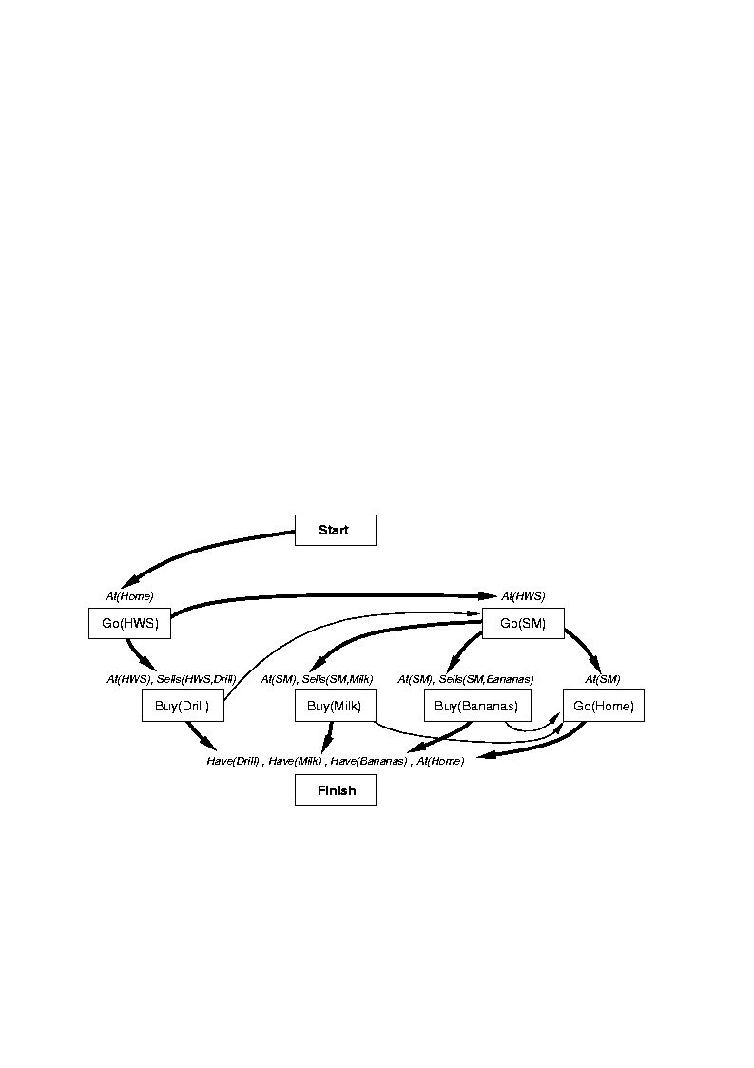
Solving the Sussman anomaly

Slide 39
Solving the Sussman anomaly
I also used the slides from chapter 11 from Russell’s (and some from chapter 7 on situation calculus)

Slide 40
Partial-Order Planning
Total-Order vs. Partial-Order Planners
is called a total-order planner, or a linear planner. Alternatively, if we only represent partial-order constraints on steps, then we have a partial-order planner, which is also called a non-linear planner. In this case, we specify a set of temporal constraints between pairs of steps of the form S1 < S2 meaning that step S1 comes before, but not necessarily immediately before, step S2. We also show this temporal constraint in graph form as
S1 +++++++++> S2
STRIPS is a total-order planner, as are situation-space progression and regression planners
Partial-order planners exhibit the property of least commitment because constraints ordering steps will only be inserted when necessary. On the other hand, situation-space progression planners make commitments about the order of steps as they try to find a solution and therefore may make mistakes from poor guesses about the right order of steps

Slide 41

Representing a Partial-Order Plan
A partial-order plan will be represented as a graph that describes the temporal constraints between plan steps selected so far. That is, each node will represent a single step in the plan (i.e., an instance of one of the operators), and an arc will designate a temporal constraint between the two steps connected by the arc. For example,
graphically represents the temporal constraints S1 < S2, S1 < S3, S1 < S4, S2 < S5, S3 < S4, and S4 < S5. This partial-order plan implicitly represents the following three total-order plans, each of which is consistent with all of the given constraints:
[S1,S2,S3,S4,S5], [S1,S3,S2,S4,S5], and [S1,S3,S4,S2,S5].

